Slide 1
Lab 03 Recitation Wall Following
Create Follow-Wall Behavior using PD control to track left & right walls, inside and outside corners
Integrate Follow-Wall and Follow-Center
Integrate Random-Wander, Avoid-Obstacle, Follow-Wall, & Follow-Center
Integrate smart homing or go to goal into the state machine

Slide 2
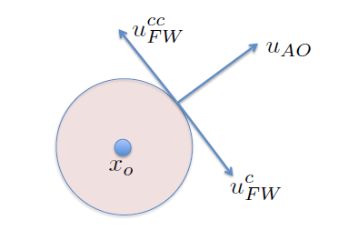
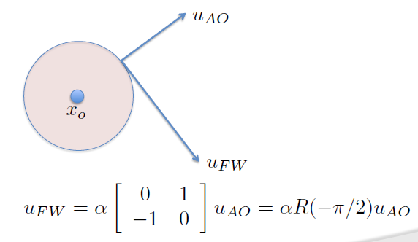
Following Walls versus Avoiding Obstacles

Slide 3
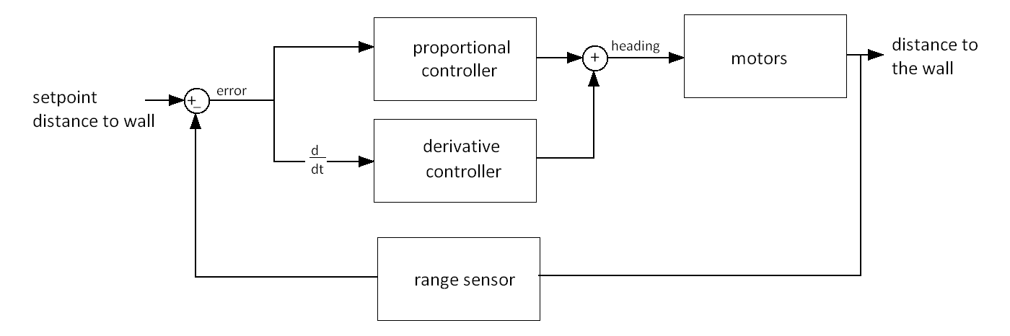
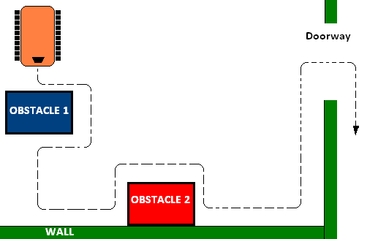
Wall Following with PD Control

Slide 4
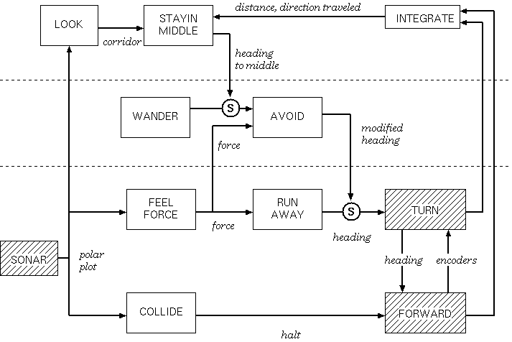
Wall Following Subsumption Architecture
Add
Follow Left & Follow Right
Notes:
Level 2: Follow Corridor
Minimal state if any
No memory
No learning
No internal models/representations of the world

Slide 5
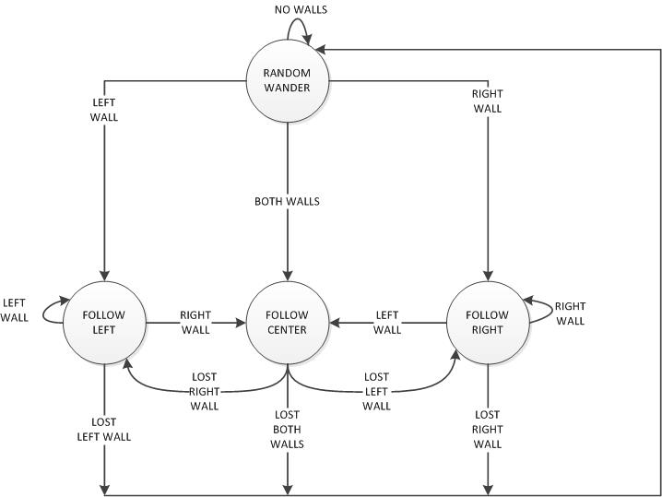
Wall Following State Diagram
Add obstacle avoidance!

Slide 6
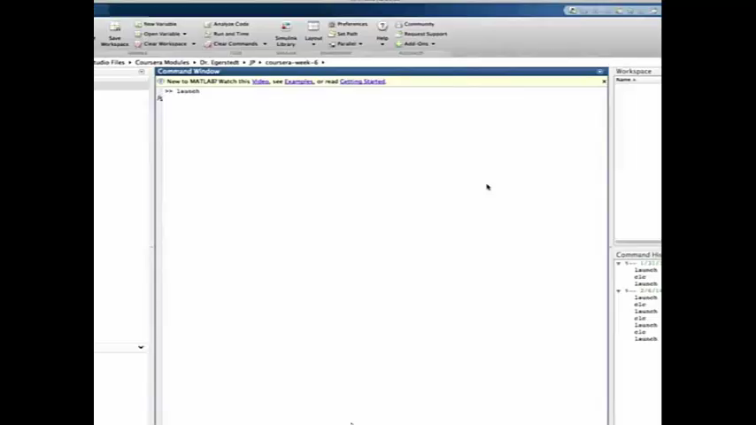
Wall Following Simulation

Slide 7
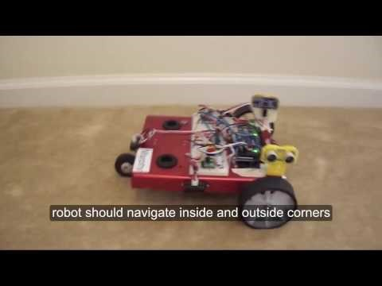
Bang-Bang Control

Slide 8

Wall Following Video

Slide 9

Wall Following Video

Slide 10
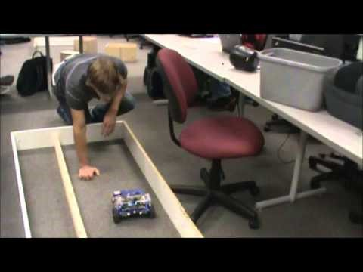
Wall Following Video

Slide 11
Pre-Lab 03
Review the Tuning of a PID Controller Using Ziegler-Nichols Method” document to prepare for the lab.
Create a state diagram with 3 states (random wander, avoid obstacle, go to goal). The inputs that transition the states are at goal, has goal, no goal, obstacle, no obstacle.
Create the state transition table for the obstacle avoidance behavior state diagram.
Create a subsumption architecture with random wander, avoid obstacle (runaway(too close), collide(front inside corner)), follow wall (left or right and include outside corner), and follow center behaviors.
OR
Create the state diagram with the following states: follow wall (left or right and outside corner), follow center, random wander, avoid obstacle (run away [too close], collide [inside corner]). Inputs to the states would be based upon the range sensors.

Slide 12

Submission Guidelines
Demos in one week
Submit memo and code by midnight on Sunday after demo to GradeScope
Comment your code with a proper heading and in-line comments and submit in Appendix of Worksheet to GradeScope

Slide 13
Lab 02 Demos
Halt (Forward, stop at obstacle, red LED)
Random Wander no Avoid obstacle (green LED)
Runaway no movement unless obstacle (yellow LED) [all 15 sensor options]
Smart Wander (Random Wander w/Avoid Obstacle)
Smart Follow (Random Wander w/Follow Object)

Slide 14
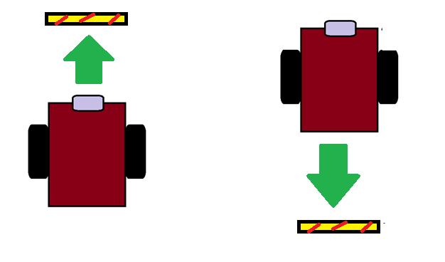
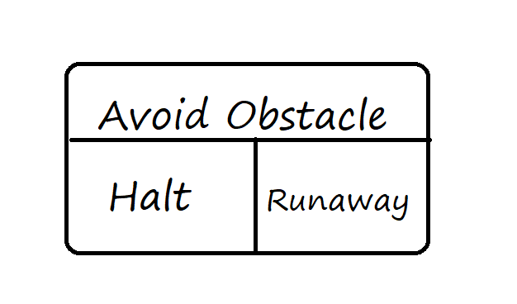
Halt (Collide) – Aggressive Kid

Slide 15
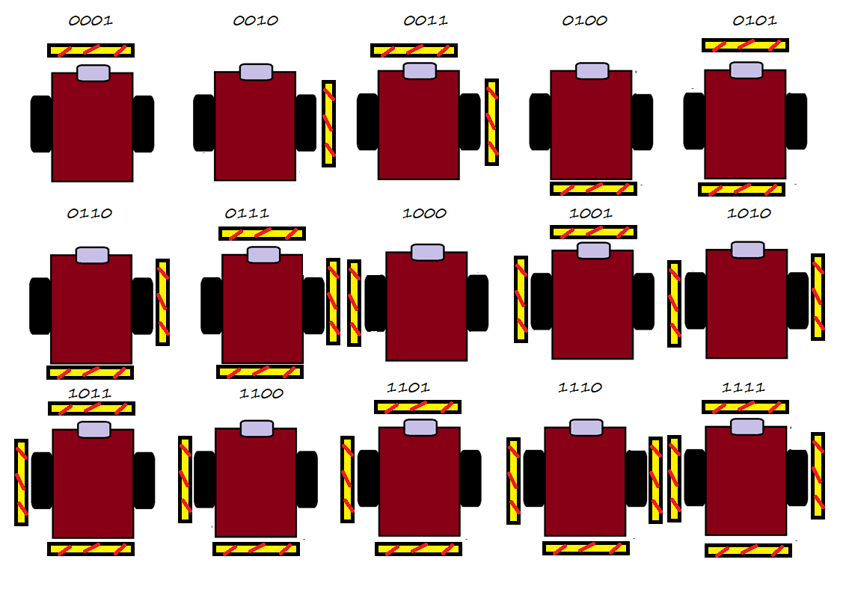
RunAway – Shy Kid

Slide 16

Pre-Lab 03 Simulator Video

